Slide 1

Mobile App Design
Project Proposal
312510017 宋彥霆
312510072 朱治瑜
312510087 曾邦誠

Slide 2
Outline
01 Motivation
02 Result
Home
About Us
Features
Contact
Service
Reserve
Login
03 Future Work
04 Contribution
05 Reference

Slide 3
01
Motivation

Slide 4
01 Motivation
⠂You can check the number of reservations directly online so you can save time waiting in line at the Gym
⠂Manage facility usage more effectively and efficiently
⠂The Contact us system allows us to better understand our members’ thoughts
Notes:
OK, I will like to introduce our new gym website. Our primary motivation in creating this platform was to enhance your overall gym experience through several key features.
Firstly, with our online reservation system, you can check the number of reservations directly from your device. This feature saves you time by eliminating the need to wait in line at the gym.
Secondly, our platform allows us to manage facility usage more effectively and efficiently by checking the reservation number online or fill out our tickets first.
Lastly, our 'Contact Us' system is designed to get better communication between you and our team.

Slide 5
02
Result

Slide 6
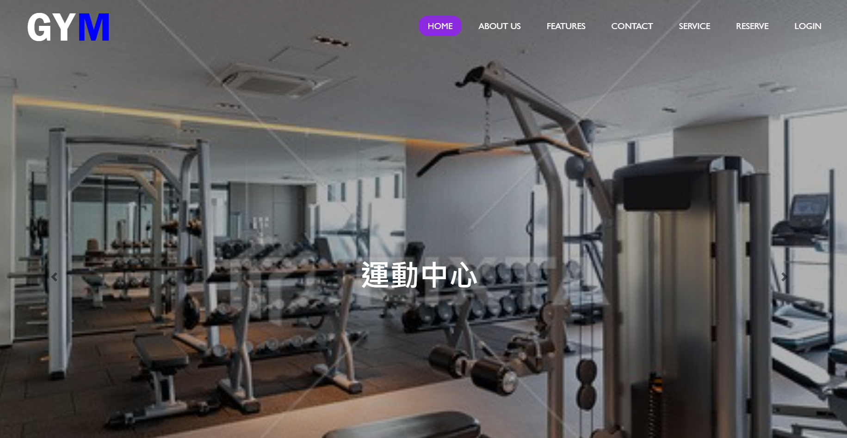
Home
Notes:
This is our website home view, we have home, about us, features, contact, service, reserve, and login dropdown list. and inside the dropdown,
we have more function in it, which will be introduced later.

Slide 7
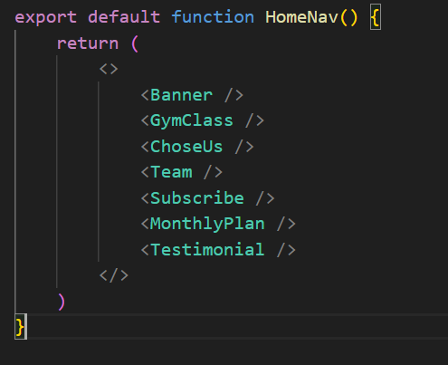
Home
Notes:
The homeNav route contain those components: Banner, Gymclass,.....
And each components we put them in each .js file respectively.

Slide 8
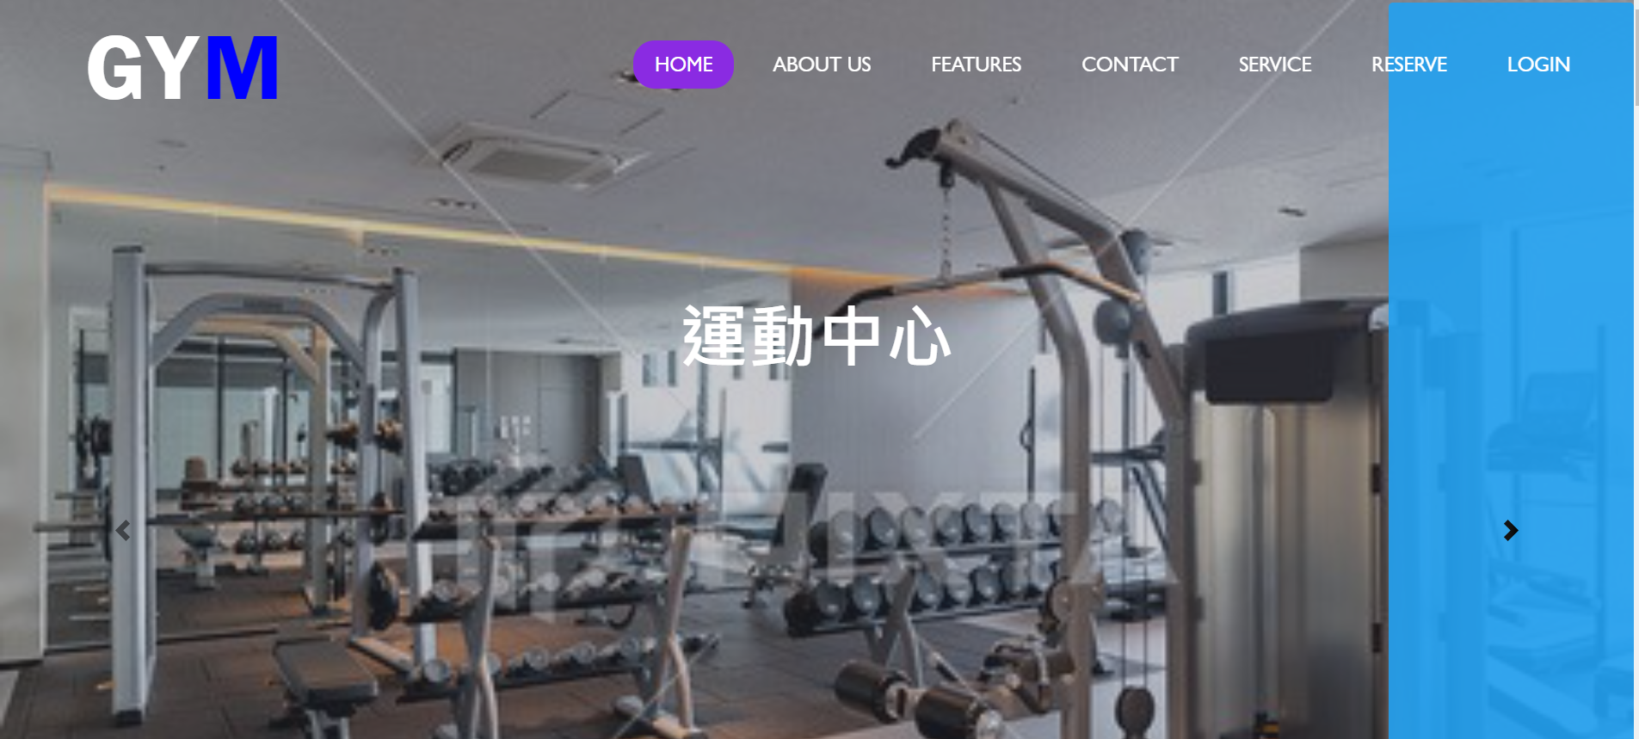
Home-banner
Notes:
This slide show the banner component do. like this blue arrow do.

Slide 9
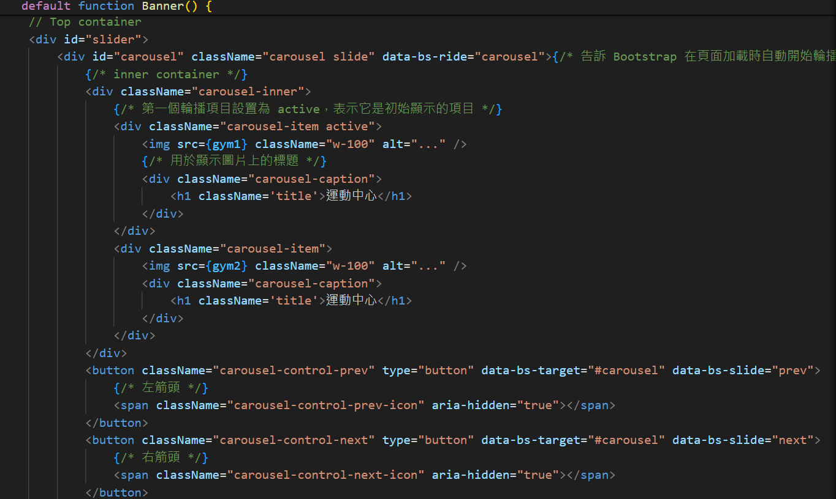
Home-banner
Notes:
This slide show the banner component do.
We first assign the one of two pictures to be active, which is mean that it will first to be presented.
and if you press the left or right arrow, it’ll be transfer to another picture.
And because we only have two image, it will takes turn to display.
This is the left button, and that is right button.

Slide 10
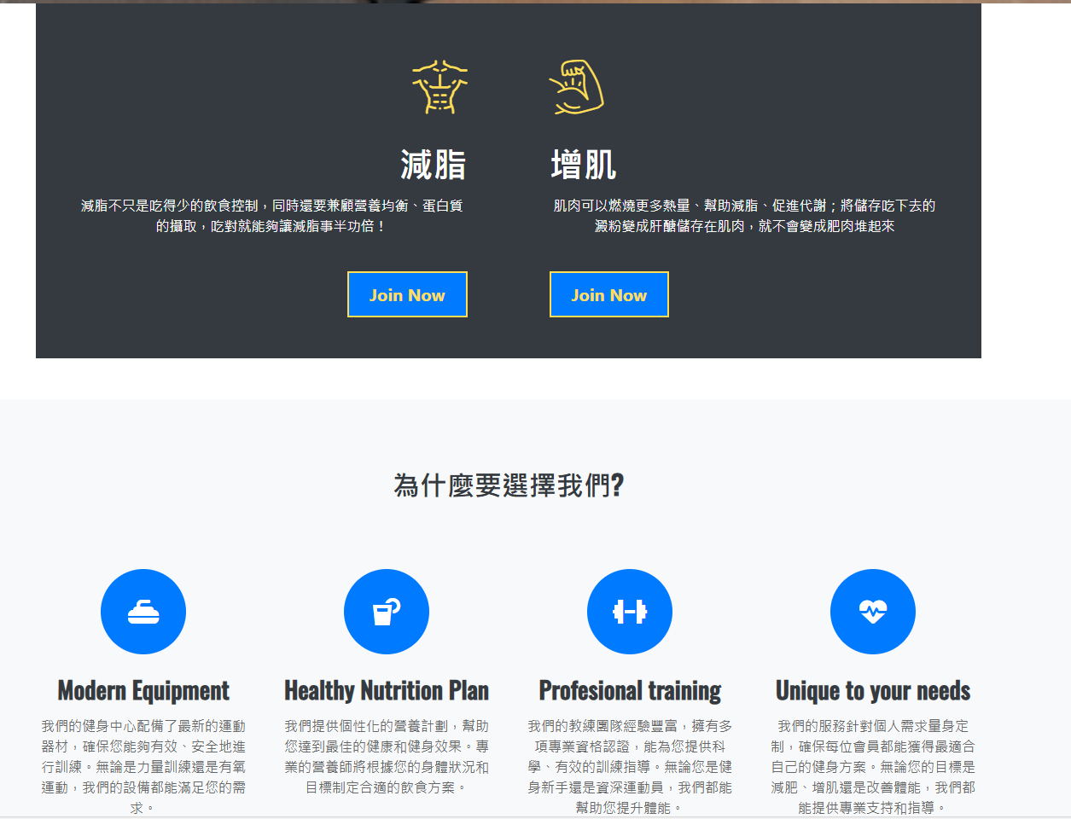
Home - Gym class and choose us
Notes:
This slide show our gym class and why choose us, and we add the two Join us button to connect to Register page.
And Why choose us js file also have four button, to connect to default page, that is Home page.

Slide 11
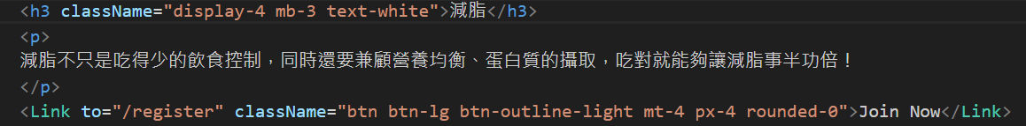
Home - Gym class
Notes:
This slide show the code in our gym class part. As mentioned above, we add the two Join us button to connect to Register page.
and how this work is based on the Link function provided by react, so when we press the button, it will jump to Register page.
And how the Register page function work, it will be introduced later.

Slide 12
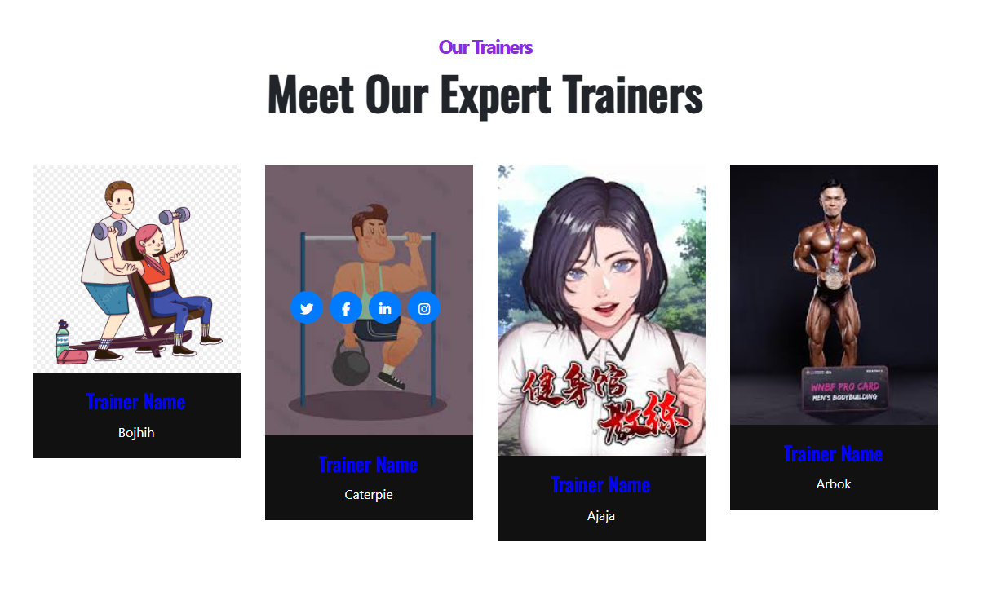
Home - Reservation for your own coach
Notes:
And this slide is displayed our four coaches in or gym, we can know the coach instagram, twitter, linkin, and facebook, and if you press the button, it will switch to home page, which is default page.

Slide 13

Home - Subscribe function
Notes:
We also have function to subscribe us feature, you can type your email.

Slide 14
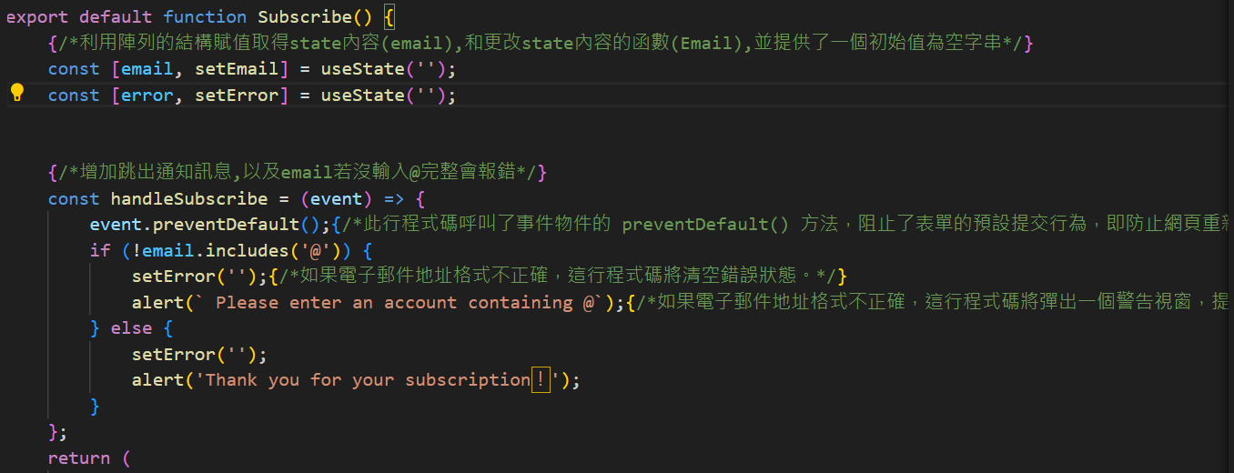
Home - Subscribe function
Notes:
As the code show, if you don’t contain @, it will have the alert messages.
And only if you type the correct email, and we will have thank you message to jump to page.

Slide 15
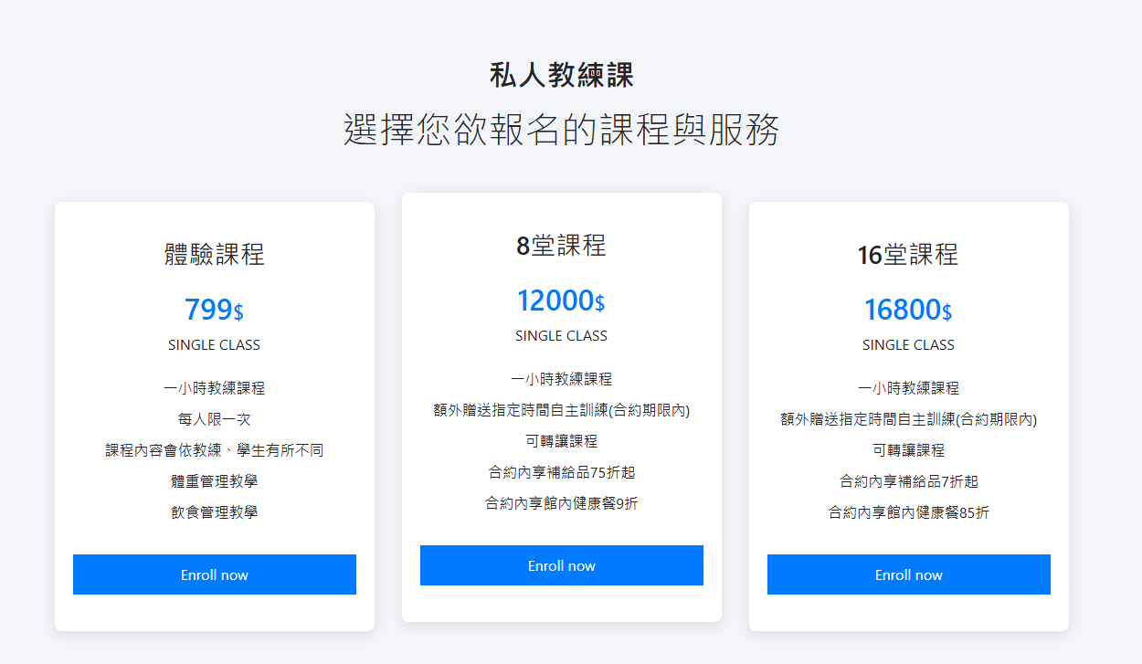
Home - Monthly plan
Notes:
And this slide is displayed our three monthly plan, As shown, there is three Enroll now button, and if you press it, we design the link to the Contact us page.
And other method to design these is same as above, so we skip these quickly, and demo directly.

Slide 16
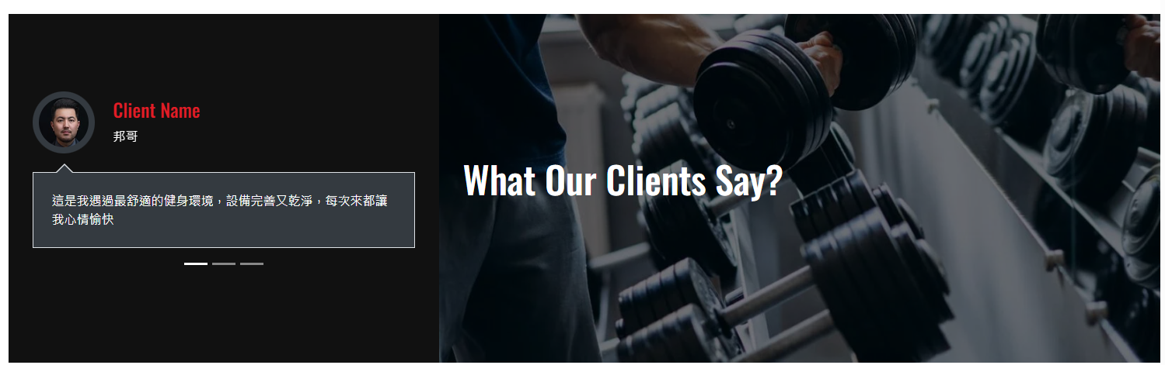
Home - Client comments
Notes:
This is the place to place the client comments, and there are three carousel structure.

Slide 17
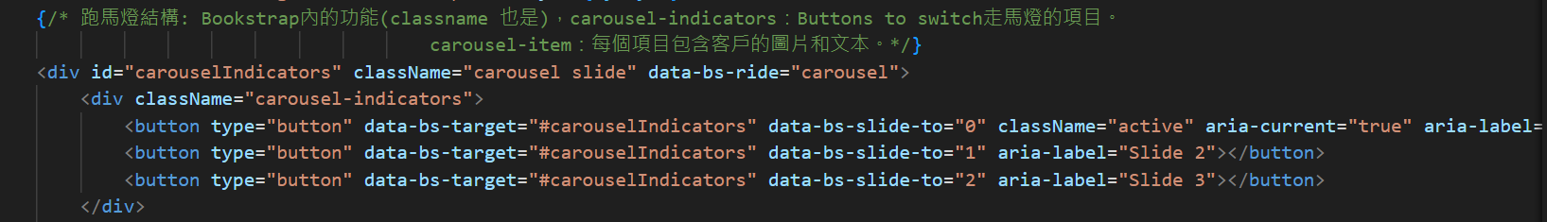
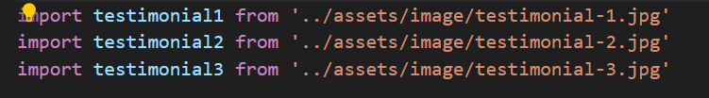
Home - Client comments
Notes:
There are three carousel structure, which will takes turn to display the three image and corresponding information.
Like the code show above, if you press specific button, you will change the slide to other people, and this blue testimonial is the img delivered from this route.

Slide 18
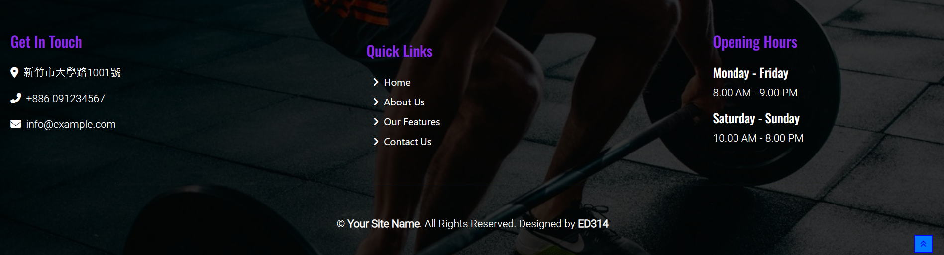
Home - footer
Notes:
Oh, it is Worth to talk about the footer. As the red line circled, it’s a cool featured I would like to introduce.
If you press this blue button, it can jump onto the top of the home page, and the detailed code will show you next slide.
In addition, our footer contains some informations like Get in touch, Quick links, Opening Hours….

Slide 19
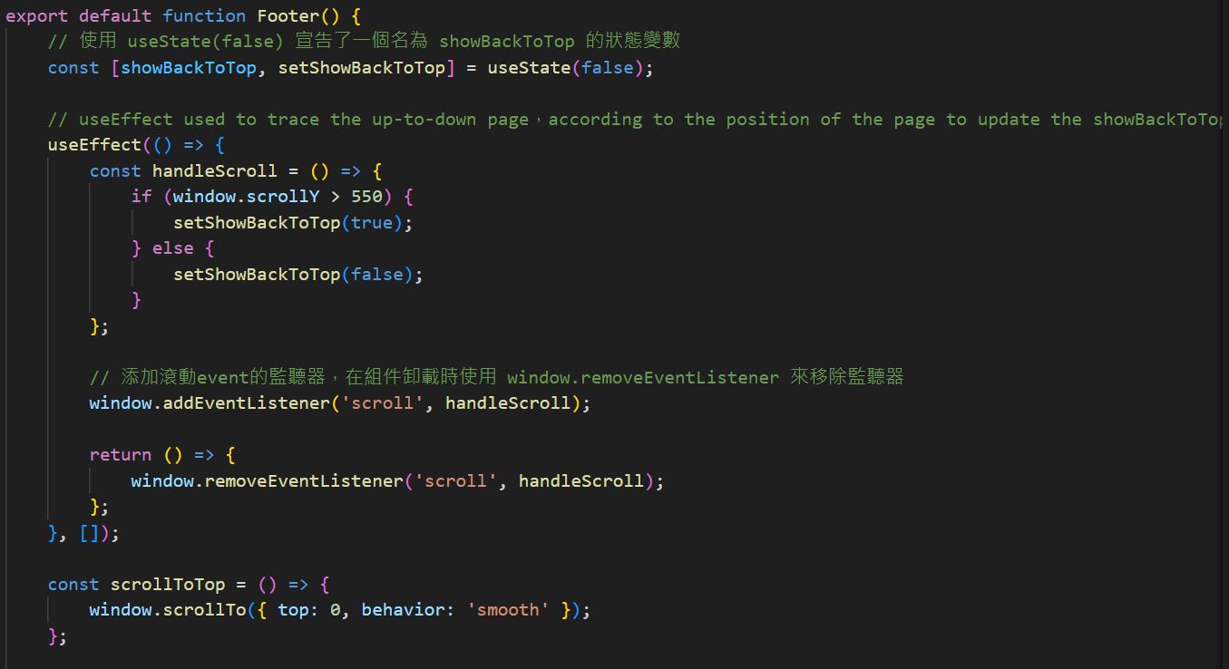
Home - footer
Notes:
In this code, useEffect used to trace the up-to-down page，according to the position of the page to update the showBackToTop state.
As shown, if window.scrollY is greater than 550, then this setShowBackToTop component will appear.
And in the ScrollToTop state, I set the action to be smooth, so the window can jump to top smoothly.

Slide 20
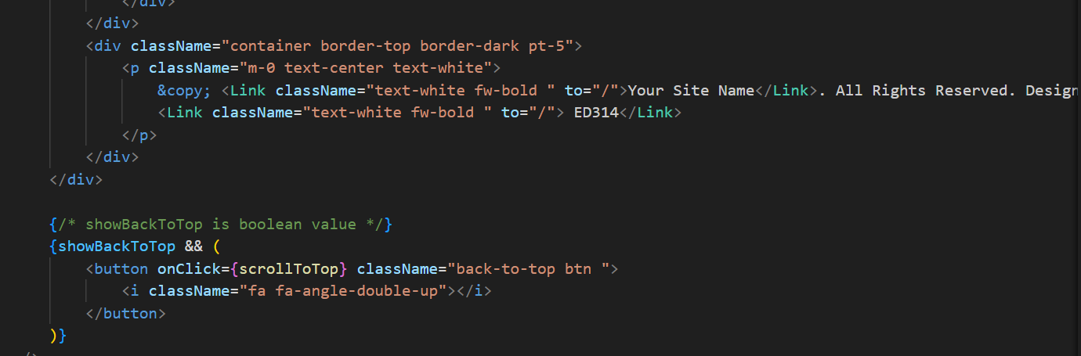
Home - footer
Notes:
These code shows some information in footer that is linked to corresponding position.
And the code below, there is the button to control scrolltoTop, and if you press it, it will trigger the event to ScrollToTop.

Slide 21
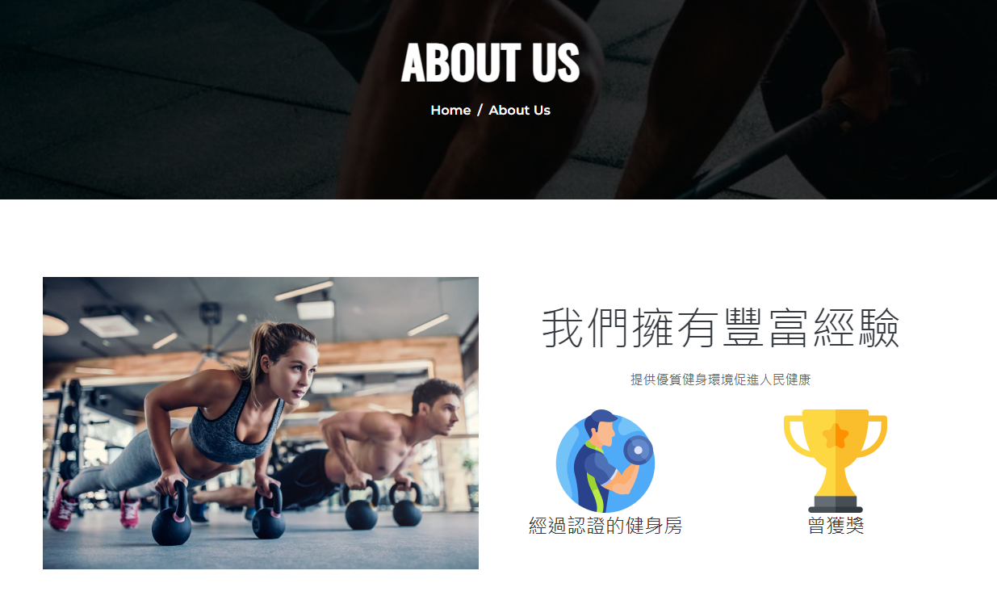
About us
Notes:
This is the page to put some information to let customers know more about our gym.
I think I can demo it directly. because there is no special function in our code.

Slide 22
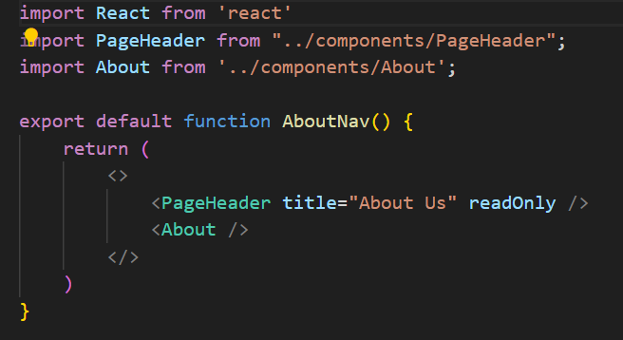
About us
Notes:
The AboutNav route contain those components: PageHeader, About

Slide 23
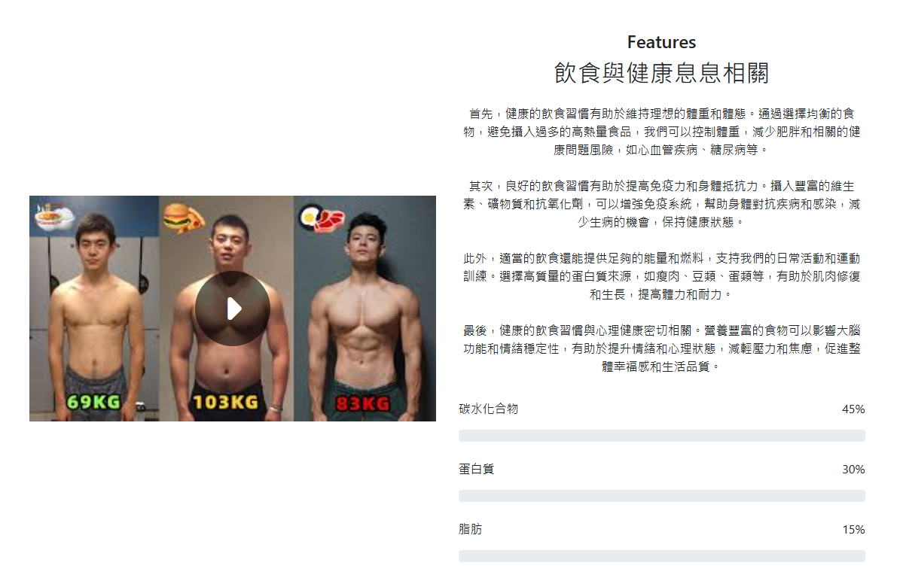
Features
Notes:
The following is a description of some health-related content featured on our "features" page, where we explore the relationship between health and diet. Below this description, there is a bar chart illustrating the recommended daily intake of nutrients. On the left side, there is a video.

Slide 24
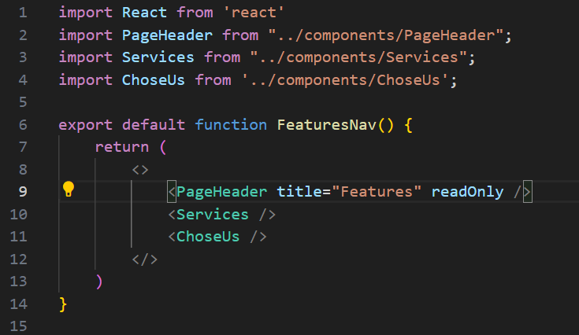
Features
Notes:
The FeatureNav route contain those components: Pageheader service choseus

Slide 25
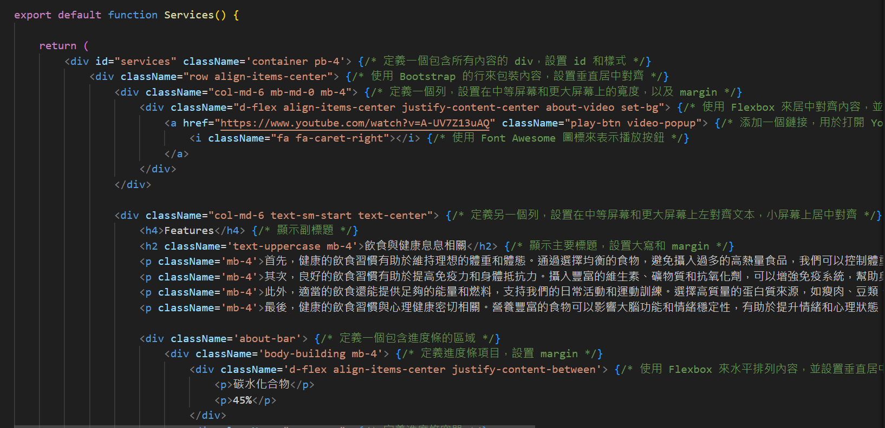
Features - service
Notes:
The youtube link is to be achieved by using href attributes like this line in the code.

Slide 26
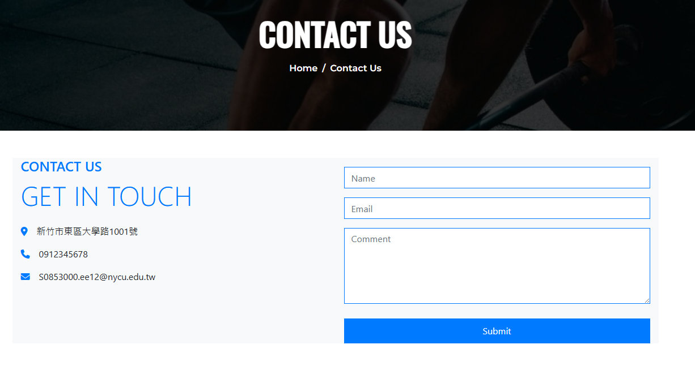
Contact
Notes:
This is our contact us interface, we can see our address, phone number, and contact email . Users can enter their suggestions here. For example, we can enter our name here.

Slide 27
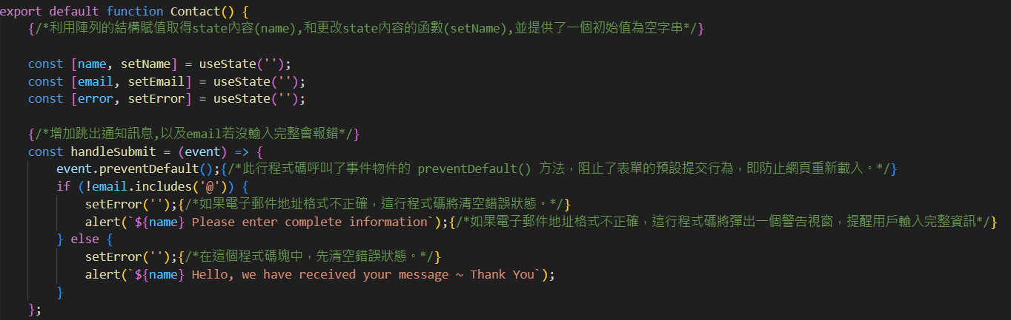
Contact
Notes:
We use an array structure to assign and obtain the state content (name), and a function to update the state content (setName), providing an initial value as an empty string
Here, we added a function to jump out a notification, and an error will be shown if the email is not entered completely.

Slide 28
Service
BMI calculation
Ticket
Questions
function will be demo later

Slide 29
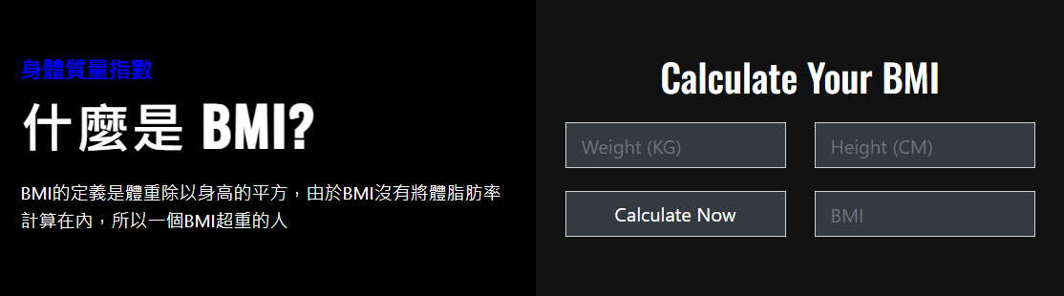
1.Service - BMI calculation
Notes:
I think everyone knows what is BMI…，and On our website, we provide a calculator that makes it easy for everyone to calculate BMI.

Slide 30
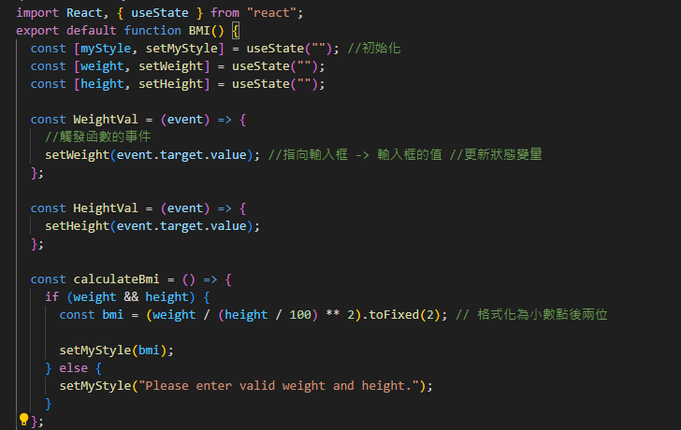
Notes:
When we change the weight and height values of the input box, these two functions will be triggered to change the values；And when we press "calculate now," it will calculate the BMI value for us, and the result will be rounded to two decimal places.；After the calculation, this function(setmystyle) will save the result back to mystyle.

Slide 31
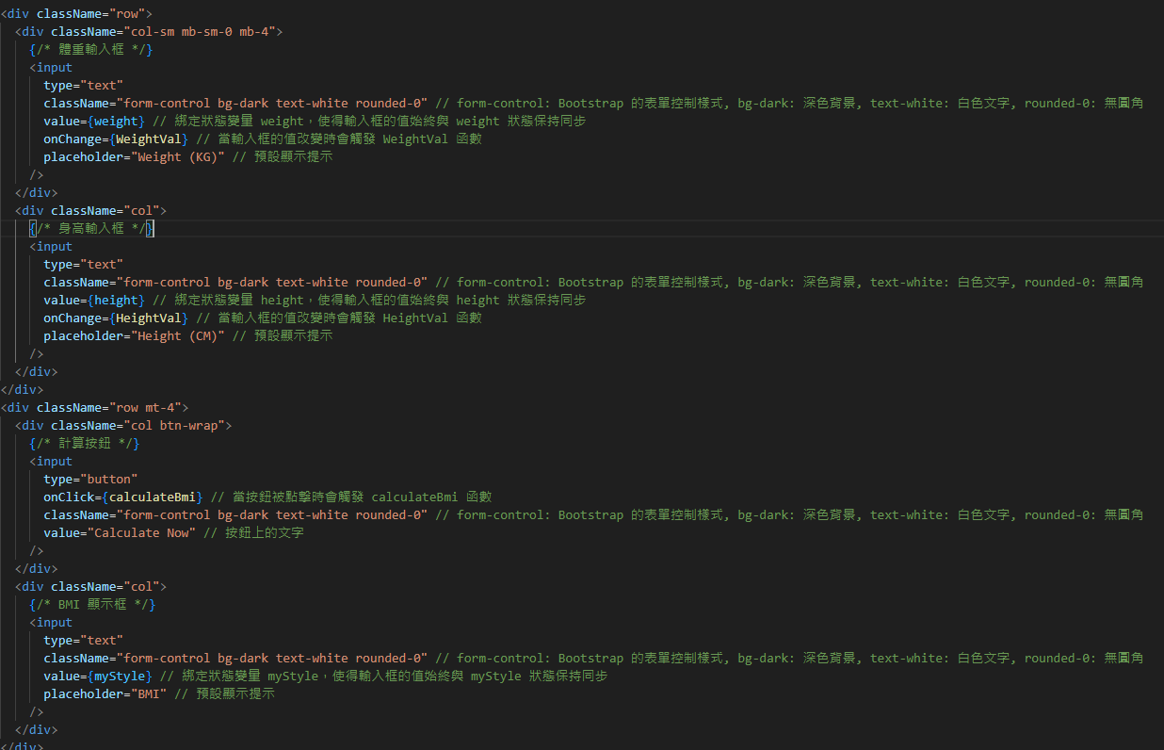
Notes:
Here is the input box mentioned on the previous page, which will trigger this function when the value changes.

Slide 32
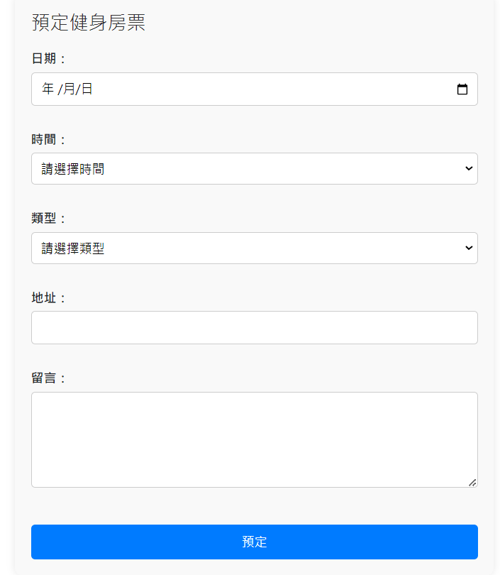
2.Service - Tickets
Notes:
This is the interface for reserving gym tickets. In this interface, we can select the date and time period the user wants and the type of exercise they want to reserve, and also can leave the user's address or any notes or messages they want to leave me.

Slide 33
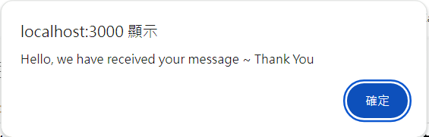
2.Service - Tickets
Notes:
When we press the submit button, we also use alert to pop out the received notification.

Slide 34
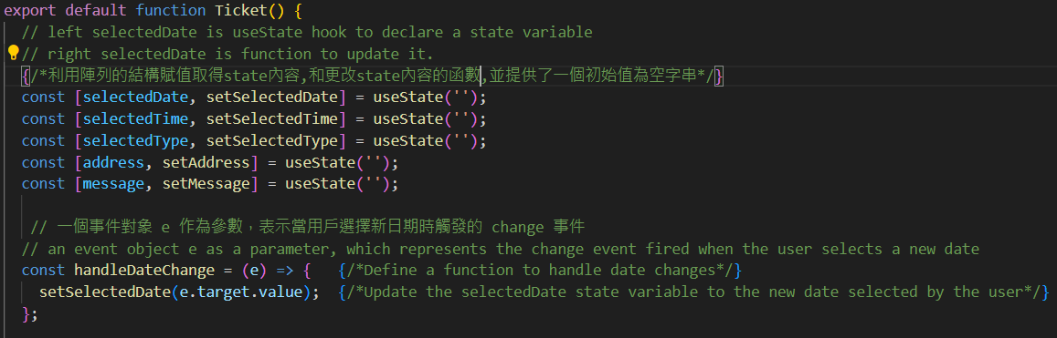
2.Service - Tickets
Notes:
When we press the submit button, we also use alert to pop out the received notification.

Slide 35
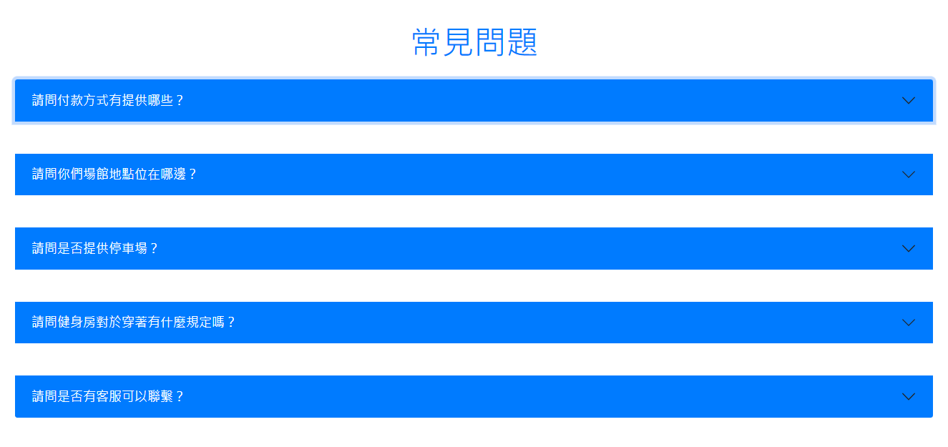
3.Service - Questions(FAQ)
Notes:
This is the interface for some common questions. We can allow users to view the questions that most users want to ask here to reduce everyone's time and improve efficiency.And use accordion style to reduce the layout

Slide 36
Reserve
User Count
Venue Reservation
function will be demo later

Slide 37
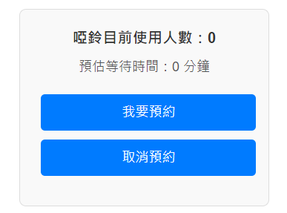
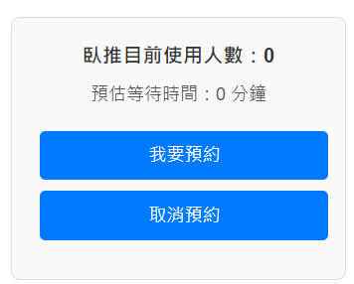
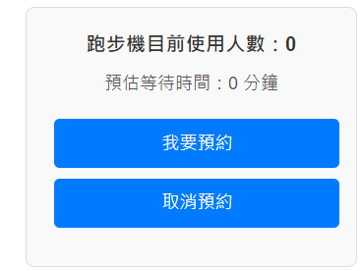
1.Reserve - User Count
Notes:
This is our online reservation system. You can directly book and cancel the equipment you want to use online.

Slide 38
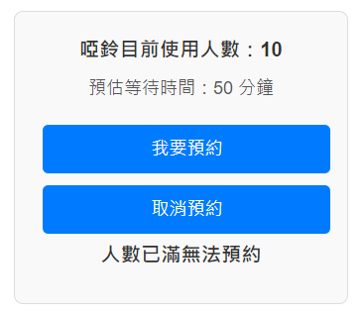
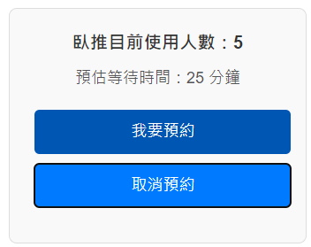
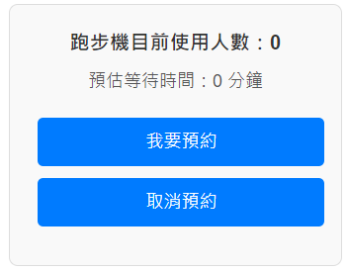
1.Reserve - User Count
Notes:
Additionally, you can see the number of users and the waiting time in real-time on the internet, so it can solve the problem of users being unable to use the equipment when they arrive at the site
If the number of reservations reaches 10 people, it will display that the maximum capacity is reached and no more reservation can be made.

Slide 39
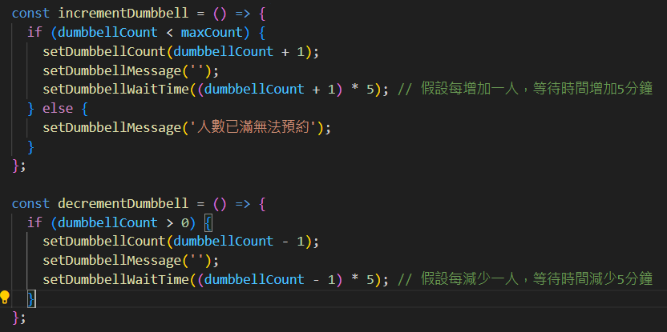
1.Reserve - User Count
Notes:
Confirm the number of people currently using the equipment and even estimate how long it will take

Slide 40
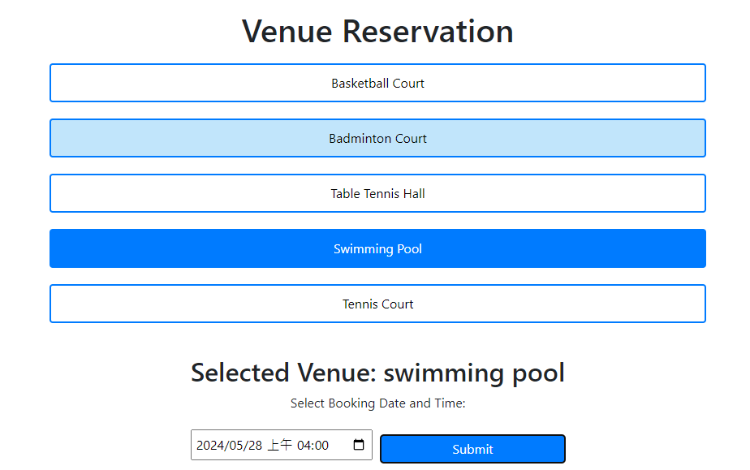
2.Reserve - Venue Reservation
We can choose a sports venue and reserve the time you want
Notes:
We can choose a sports venue and reserve the time you want，and You should choose the venue first, and then the option to reserve the time will be displayed.

Slide 41
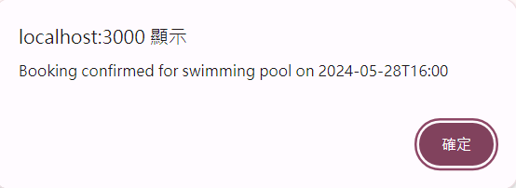
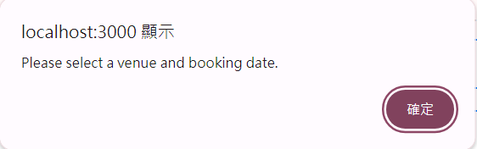
After you submit :
If you don’t select :
Notes:
When you fill out the form correctly and press submit, a notification will pop up as shown in the image above. However, if you miss any item and press submit, the notification shown in the image below will appear.

Slide 42
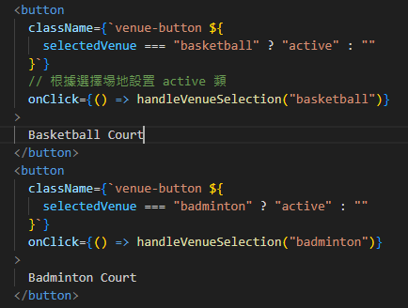
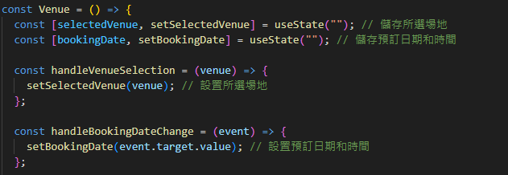
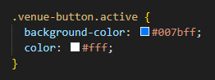
Notes:
Here we use a conditional statement for the classname, so the selected venue will have an additional classname added, and its CSS will be different from the others. For example, when you press the basketball, it triggers the handleVenueSelect function and returns this value to "selectedVenue."So now, "selectedVenue" is "basketball," and it equals this, so the classname will have an additional "active"

Slide 43
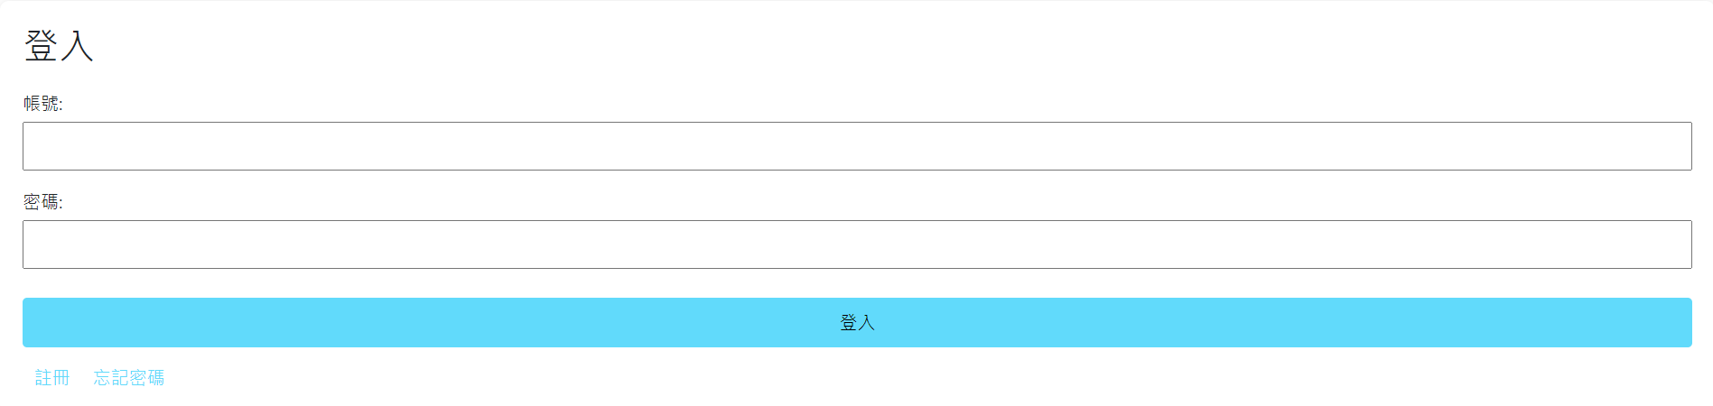
Login
Notes:
This is a standard login page where you can enter your username and password. If you haven't registered, you can choose to click on "register," which will then take you to the registration page. We also have another design that will be discussed in the next page.

Slide 44
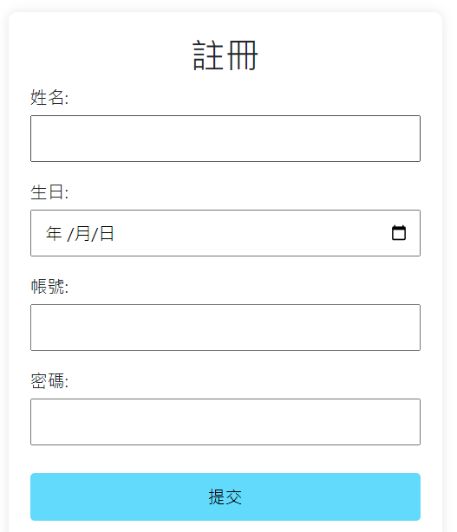
Notes:
This is our registration page, where you will need to enter your name, date of birth, and set your username and password.

Slide 45
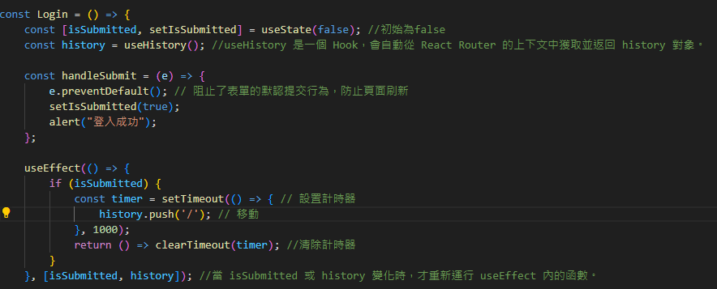
Notes:
Our design is that after you successfully log in, it will wait for about 1 second and then redirect to the home page.
1. e.preventDefault(); prevents the form's default submission behavior, preventing the page from refreshing.
2. Only re-run the function inside useEffect when isSubmitted or history changes.
3. useHistory is a Hook that automatically fetches and returns the history object from the React Router context. This history object contains records of the pages you have visited.

Slide 46
04
Future work

Slide 47
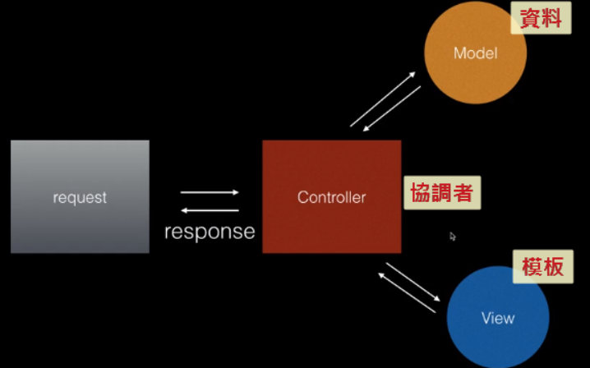
Use Node.js to develop the App
Notes:
If we want to further enhance our website, relying solely on the frontend is not enough. We need to integrate a backend database to store user records and add more functionalities.
發出的 request 會由 Controller 來處理
接著 Controller 會和 Model 拿取 data
Controller 再把拿到的資料給 View，由 View 提供的 template
最後 Controller 再結合 data 和 template，回傳 response

Slide 48
05
Contribution

Slide 49
Contribution
Make reservations for each equipment
Confirm the number of people currently using the equipment
Even estimate how long it will take
Venue reservation for all categories of sports
Caculate your BMI
Reserve your ticket
Information about each trainer
Subscribe to our newsletter
Choose from various membership options

Slide 50
Thank you for listening!

Slide 51
06
Reference

Slide 52
Reference
[1] https://react.dev/
[2] https://www.w3schools.com/html/default.asp
[3] https://www.anytimefitness.tw/gym-reservation-how-it-works/
[4] https://www.stepx.com.tw/

